Slide 1
Monochrome tv transmitter
Monochrome TV Transmitter: Figure shows the simplified block diagram of a television transmitter. The video signals obtained from camera tube are applied to a number of video amplifier stages. First stage is located in camera housing to increase weak signal voltage to such a level as to be transmitted over a coaxial cable to the succeeding amplifier stages.
Notes:
© Copyright PresentationGO.com – The free PowerPoint template library

Slide 2
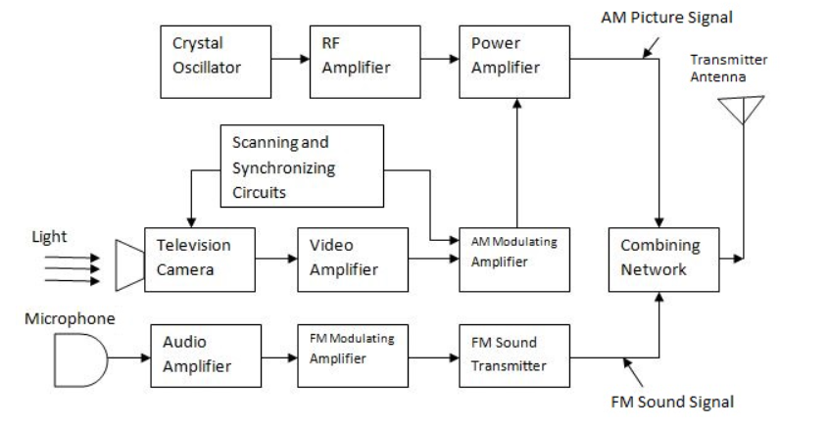
Notes:
© Copyright PresentationGO.com – The free PowerPoint template library

Slide 3
Synchronizing generator produces sets of pulses to operate the system at appropriate timings. This unit includes wave generating and shaping circuits. Eg: Multivibrator circuit, blocking oscillator circuit and clipping circuits etc. The repetition rates of the pulse trains are controlled by frequency stabilized master oscillator.
The horizontal synchronizing pulses are applied to horizontal saw-tooth generator; vertical synchronizing pulses are applied to vertical deflection saw-tooth generator; two sets of blanking pulses are applied to control grid of camera tube to blank it during vertical and horizontal retrace; and a pulse train consisting all above pulse groups is applied to video-amplifier channel for transmission to receiver.
Notes:
© Copyright PresentationGO.com – The free PowerPoint template library

Slide 4
.
The carrier when amplitude modulated with video signal (BW = 5 MHz) generates two sidebands and the total bandwidth, required for TV channel would be 10 MHz which is too large. Therefore vestigial sideband transmission in which one sideband – (say upper) is transmitted in full along with reduced second sideband is used. For this purpose, output of the final RF amplifier is applied to a vestigial sideband filter which suppresses the undesired portion of the lower sideband of the modulated wave.

Slide 5
Thank you Everybody

